Slide 1
CONDUCTION HEAT TRANSFER
INTRODUCTION
In this unit, steady state heat conduction problems involving one-dimensional temperature distribution are treated. The concept of thermal resistance for cases with one-dimensional steady state temperature distribution is introduced and the use of equivalent thermal circuits for analysing problems with multiple layers of different materials. The application of heat transfer to extended surfaces is also discussed. A general heat conduction equation in a three dimensional approach is also derived.
LEARNING OBJECTIVES
After studying this unit, you should be able to:
Solve steady- state conduction problems involving one-dimensional temperature distribution.
Understand the concept of thermal resistance for cases with one-dimensional steady temperature distribution.
Demonstrate the use of equivalent thermal circuits for analyzing problems with multiple layers of different materials.
Analytically determine heat transfer rates in extended surfaces.
Understand the concept of contact thermal resistance in heat transfer analysis.
Examine the effect of internal heat generation on temperature distribution and heat transfer.
Solve transient problems with uniform temperature distribution.
1
Notes:
ME 366: HEAT TRANSFER LECTURE #2, 2012 1

Slide 2
DEFINITION OF CONDUCTION HEAT TRANSFER
Heat conduction is that mode of energy transfer between solids brought into direct contact having different temperatures or within solids as a result of temperature difference or with liquids or gases as a result of temperature difference without an appreciable movement of matter. This takes places as a result of kinetic motion or direct impact of molecules, as in the case of fluid at rest, and by the drift of electrons as in the case of metals. In a solid, which is a good electric conductor a large number of free electrons move about in the lattice; hence materials that are good electric conductors are generally good heat conductors (e.g. copper, silver etc)
2
Notes:
ME 366: HEAT TRANSFER LECTURE #2, 2012 2

Slide 3
ONE DIMENSIONAL STEADY STATE CONDUCTION
The term one-dimensional refers to the fact that only one co-ordinate is needed to describe the spatial variation of the dependent variables.
Hence, in a one-dimensional system, temperature gradients exist along only a single space coordinate direction, and heat transfer occurs exclusively in that direction.
The system is characterised by steady state conditions if the temperature at each point is independent of time.
We begin our consideration of one-dimensional, steady state conduction by discussing heat transfer with no internal generation in common geometries. The concept of thermal resistance (analogous to electrical resistance) is introduced as an aid to solving conduction heat transfer problems. The effect of internal heat generation on the temperature distribution and heat rate is then treated. The general heat conduction equation is introduced. Finally, conduction analysis is used to describe the performance of extended surfaces or fins, wherein the role of convection at the external boundary must be considered.
3
Notes:
ME 366: HEAT TRANSFER LECTURE #2, 2012 3

Slide 4
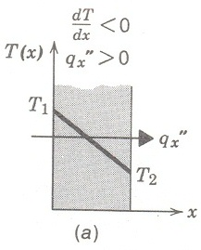
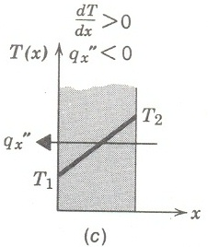
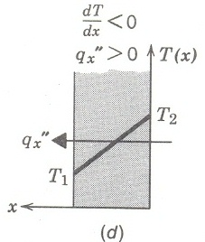
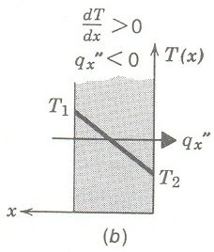
DIRECTION OF HEAT FLOW IN RESPONSE TO A TEMPERATURE GRADIENT
Figure 5 illustrates the direction of heat flow, in a one-dimensional coordinate system when the gradient, dT/dx, is positive or negative. Note that conduction heat transfer is determined using Fourier’s Law
4
Notes:
ME 366: HEAT TRANSFER LECTURE #2, 2012 4

Slide 5
THERMAL DIFFUSIVITY
The product called heat capacity is frequently used in heat transfer analysis and it represents the heat storage capacity of the material per unit volume. In heat transfer analysis, the ratio of the thermal conductivity to the heat capacity is an important property termed the thermal diffusivity , which has units of m²/s:
The thermal conductivity λ represents how well a material conducts heat, and the heat capacity represents how much energy a material stores per unit volume.
The larger the thermal diffusivity, the faster the propagation of heat into the medium. A small value of thermal diffusivity means that heat is mostly absorbed by the material and a small amount of heat will be conducted further. Thermal diffusivity ranges from for water to for silver. The thermal diffusivities of beef and water are the same, since meat as well as fresh vegetables and fruits are mostly water, and thus they possess the thermal properties of water
5
Notes:
ME 366: HEAT TRANSFER LECTURE #2, 2012 5

Slide 6
HEAT CONDUCTION IN A PLANE WALL
For one-dimensional heat conduction in a plane wall, temperature is a function of the x coordinate only and heat is transferred exclusively in this direction. In Figure 6a, a plane wall separates two fluids of different temperatures. Heat transfer occurs by convection from the hot fluid at to one surface; of the wall at T_{∞1} , by conduction through the wall, and by convection from the outer surface of the wall at to the cold fluid at T_{∞2}.
Notes:
ME 366: HEAT TRANSFER LECTURE #2, 2012 6

Slide 7
Figure 6a
Heat conduction in a plane wall of thickness L
Notes:
ME 366: HEAT TRANSFER LECTURE #2, 2012 7

Slide 8
1-dimensinal steady-state conduction equation
Heat equation for one dimensional heat flow
The temperature distribution in the wall can be determined by solving the heat equation with the proper boundary conditions imposed. The heat equation for a plane wall of constant cross-section is:
(2.1)
Notes:
ME 366: HEAT TRANSFER LECTURE #2, 2012 8

Slide 9
Solving the established differential equation (2.1)
If the thermal conductivity, λ, of the wall material is assumed constant then,
(2.2)
To find values of the constants we apply the boundary conditions of the first kind at
x = 0 and x =L, in which case
Applying the conditions to the general solution, we have:
(2.3)
From equation (2.3), it is evident that for one-dimensional, steady state heat conduction in a plane wall with no heat generation and constant thermal conductivity, the temperature varies linearly with x.
Now that we have the temperature distribution, we can use the Fourier's law to determine the conduction heat transfer rate. That is,
(2.4)
Notes: a. A_{x} is the area of the wall normal to the direction of heat transfer and, for the plane wall, it is a constant independent of x.
b. The heat flux, is obtained by dividing by A_{x}
Notes:
ME 366: HEAT TRANSFER LECTURE #2, 2012 9

Slide 10
THERMAL RESISTANCE
Just as an electrical resistance is associated with the conduction of electricity, a thermal resistance is associated with the conduction of heat. Defining resistance as the ratio of a driving potential difference to the corresponding transfer rate, it follows from Equation 2.4 that the thermal resistance for conduction is,
i.e. ,
Hence,
(2.5)
Similarly, for electrical conduction in the same system, Ohm's law provides an electrical resistance of the form
(2.6)
Comparing Equations 2.5 & 2.6, the heat flow rate is analogous to electric current I, while the temperature difference (T_{s,1} – T_{s},₂) is analogous to the potential difference E₁ – E₂. We shall now develop expressions for computing the thermal resistance for convection and radiation.
A thermal resistance may also be associated with heat transfer by convection at a surface. From Newton’s law of cooling,
(2.7)
The thermal resistance for convection is then
(2.8)
The equivalent thermal circuit for the plane wall with convection surface conditions is shown in Figure 6b. The heat transfer rate may be determined from separate considerations of each element in the network. Since is constant throughout the network, it follows that
(2.9)
In terms of the overall temperature difference, , and the total thermal resistance, , the heat transfer rate may also be expressed as
(2.10)
Because the conduction and convection resistances are in series and may be summed, it follows that
(2.11)
Notes:
ME 366: HEAT TRANSFER LECTURE #2, 2012 10

Slide 11
Thermal resistance for radiation effect
Another resistance may be pertinent if a surface is separated from large surroundings by a gas. In particular, the radiation exchange between the surface and its surroundings may be required, and the rate is determined from equation (1.7). lt follows that a thermal resistance for radiation may be defined as:
(2.12)
Notes:
ME 366: HEAT TRANSFER LECTURE #2, 2012 11

Slide 12
HEAT CONDUCTION IN A COMPOSITE WALL.
Equivalent thermal circuits may also be used for more complex systems, such as composite walls. Such walls may involve any number of series and parallel thermal resistances due to layers of different materials. Consider the series composite wall below. The one-dimensional heat transfer rate for this system may be expressed as
Notes:
ME 366: HEAT TRANSFER LECTURE #2, 2012 12

Slide 13
COMPOSITE WALL
The heat transfer through the composite wall is given by
Notes:
ME 366: HEAT TRANSFER LECTURE #2, 2012 13

Slide 14
Overall heat transfer coefficient, U
With composite system it is convenient to work with an overall heat transfer coefficient, U, which is defined by an expression analogous to Newton’s law of cooling.
Accordingly, (2.16)
where U is the overall temperature difference. The overall heat transfer coefficient is related to the total thermal resistance, and from Equations (2.13) and (2.16) we see that . Hence, for the composite wall of Figure 7,
(2.17)
In general, we may write (2.18)
Notes:
ME 366: HEAT TRANSFER LECTURE #2, 2012 14

Slide 15
Possible representation of series-parallel composite wall configurations
Composite walls may also be characterised by series-parallel configurations, such as that shown in Figure 8.
Notes:
ME 366: HEAT TRANSFER LECTURE #2, 2012 15

Slide 16
Contact Resistance
It has been noted and documented composite systems, the temperature drop across the interface between materials may be appreciable. This temperature change may be attributed to what is known as the thermal contact resistance, R_{t,c}. The effect is shown in Figure 10, and for a unit area of the surface, the resistance is defined as
Notes:
ME 366: HEAT TRANSFER LECTURE #2, 2012 16

Slide 17
Thermal contact resistance
The contact resistance for the system shown is given by
The heat transfer through the interface is the sum of the heat transfers through the solid contact spots and the gaps in the non-contact areas and can be expressed as:
Notes:
ME 366: HEAT TRANSFER LECTURE #2, 2012 17

Slide 18
Factors affecting contact resistance
The value of thermal contact resistance depends on the surface roughness and the material properties as well as the temperature and pressure at the interface and type of fluid trapped at the interface.
Thermal contact resistance is observed to decrease with decreasing surface roughness and increasing interface pressure.
Thermal contact resistance can be minimised by applying thermal conducting liquid called thermal grease such as silicon oil.
Notes:
ME 366: HEAT TRANSFER LECTURE #2, 2012 18

Slide 19
RADIAL SYSTEMS
Cylindrical and spherical systems often experience temperature gradients in the radial direction only and therefore may be treated as one-dimensional.
Under steady state conditions with no heat generation, such systems may be analysed by using the standard method, which begins with the appropriate form of heat equation, or the alternative method, which begins with the appropriate form of Fourier's law.
Notes:
ME 366: HEAT TRANSFER LECTURE #2, 2012 19

Slide 20
The cylinder
A common example is the hollow cylinder whose inner and outer surfaces are exposed to fluids at different temperatures (Figure 11). For steady state conditions with no heat generation, the appropriate form of the one-dimensional heat conduction equation in cylindrical coordinates is:
(2.20)
Notes:
ME 366: HEAT TRANSFER LECTURE #2, 2012 20

Slide 21
Fourier’s Law in Cylindrical coordinates
From the Fourier's law, the rate at which energy is conducted across any cylindrical surface in the solid may be expressed as:
Notes:
ME 366: HEAT TRANSFER LECTURE #2, 2012 21

Slide 22
Solution of Equation (2.20)
Assuming the value of to be constant, Equation 2.20 may be integrated twice to obtain the general solution
To evaluate the constants we introduce the boundary conditions: and
(2.23)
Notes:
ME 366: HEAT TRANSFER LECTURE #2, 2012 22

Slide 23
Heat transfer rate in a cylindrical shell
If the temperature distribution, Equation 2.23, is now used with Fourier’s law, Equation 2.21, we obtain the following for the heat transfer rate:
the thermal resistance developed in comparison with the ohm’s law is of the form:
Notes:
ME 366: HEAT TRANSFER LECTURE #2, 2012 23

Slide 24
Composite cylindrical wall
Composite cylindrical wall is treated as follows:
Notes:
ME 366: HEAT TRANSFER LECTURE #2, 2012 24

Slide 25
Heat transfer rate in composite cylindrical wall
Rate of heat transfer is evaluated as:
Notes:
ME 366: HEAT TRANSFER LECTURE #2, 2012 25

Slide 26
Spherical Shells
For the differential control volume, energy conservation requires that .For steady-state, one-dimensional conditions with no heat generation, the appropriate form of the heat conduction equation in spherical coordinates is:
Notes:
ME 366: HEAT TRANSFER LECTURE #2, 2012 26

Slide 27
Thermal resistance for spherical shell
From Fourier’s law we can write:
Which is integrated yielding:
The thermal resistance for a spherical shell is given as:
Notes:
ME 366: HEAT TRANSFER LECTURE #2, 2012 27

Slide 28
Critical Radius of Insulation
Consider a cylindrical pipe of outer radius whose outer surface temperature is maintained constant.
The pipe is now insulated with a material whose thermal conductivity is and outer radius is , Heat is lost from the pipe to the surrounding medium at temperature , with a convection heat transfer coefficient .
The rate of heat transfer from the insulated pipe to the surrounding air can be expressed as
Notes:
ME 366: HEAT TRANSFER LECTURE #2, 2012 28

Slide 29
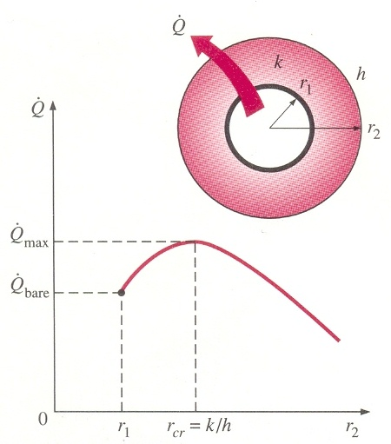
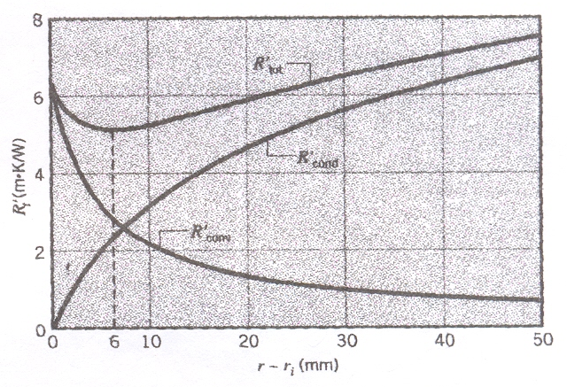
Variation of thermal resistance with cylinder radius
The variation of heat transfer with the outer radius of insulation is plotted in Figure 15. The variation of thermal resistance with radius is shown alongside. At the critical radius the thermal resistance is a minimum resulting in maximum heat transfer from the system .
Notes:
ME 366: HEAT TRANSFER LECTURE #2, 2012 29

Slide 30
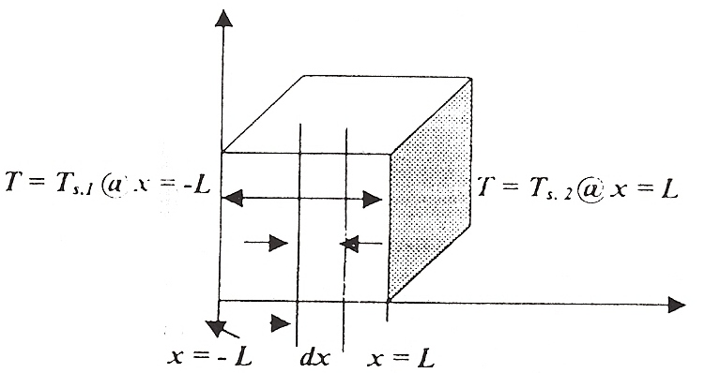
Conduction with thermal energy generation
Considering the infinitesimal volume of length dx, Energy balance yield:
Taylor’s series expansion is invoked as:
Notes:
ME 366: HEAT TRANSFER LECTURE #2, 2012 30

Slide 31
Temperature distribution for a slab with internal heat generation
According to Fourier’s Law,
if = constant
Integrating we obtain:
Substituting the boundary conditions we obtain:
and
Hence,
Notes:
ME 366: HEAT TRANSFER LECTURE #2, 2012 31

Slide 32
Temperature distribution in a slab with heat-generation
Note, however; that with generation the heat flux is no longer independent of x.
The preceding simplifies when both are maintained at a common temperature, such that T_{s1} = T_{s2} = T_{s}. The temperature distribution is then symmetrical about the mid-plane as in page 38 .
Note: A material having a thermal heat generation cannot be represented by a thermal circuit.
Notes:
ME 366: HEAT TRANSFER LECTURE #2, 2012 32

Slide 33
HEAT TRANSFER FROM EXTENDED SURFACES (CONDUCTION-CONVECTION SYSTEMS)
The term extended surface is commonly used in reference to a solid that experiences energy transfer by conduction within its boundaries, as well as energy transfer by convection (and/or radiation) between its boundaries and the surroundings.
Although there are many different situations that involve combined conduction-convection effects, the most frequent application is one in which an extended surface is used specifically to enhance the heat transfer rate between a solid and an adjoining fluid. Such an extended surface is termed a fin.

Slide 34
FIN ANALYSIS
Fin of rectangular cross section

Slide 35
Energy balance on differential element
Applying the conservation energy requirement to a differential element of Figure 20, we obtain

Slide 36
Derivation of the general differential equation
From Fourier’s law, we know that
From Taylor’s series expansion we write:
Substituting the foregoing rates into the energy balance, we obtain
or

Slide 37

Fins of uniform constant cross-section
We consider straight rectangular and pin fins of uniform cross section (Figure 20). Each fin is attached to a base surface of temperature and extends into a fluid of temperature . For the prescribed fins, is a constant and is the surface area measured from the base to x and P is the fin perimeter. Accordingly, with and , Equation 2.45 reduces to:
defining an excess temperature as
and
$$m^{2}=\frac{\text{h}\text{P}}{\text{k}{\text{A}}_{c}}$$

Slide 38

Solving the constitutive fin differential equation --------(2.48)
$$m^{2}=\frac{\text{h}\text{P}}{\text{k}{\text{A}}_{c}}$$
Equation 2.48 is a linear, homogeneous, second-order differential equation with constant coefficients. Its general solution is of the form:
---------------(2.49a)
We seek to equation 2.49a for the following three boundary conditions:
Boundary conditions
The fin is infinitely long (Case 1)
Insulated at the end (Case 2)
Convection at the end (Case 3)

Slide 39
CASE 1: INFINITELY LONG FIN
Case 1: (Infinitely long fin, L = x = ∞)
θ = 0 @ x = ∞
. Note that this condition will be satisfied by but not by the other prospective solution function
Since it turns to infinity as x gets larger.
C₁ = 0 and C₂ = θ_{b}

Slide 40
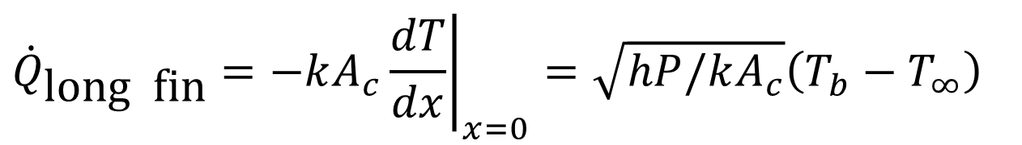
CASE 1 CONCLUDED
The temperature variation along the fin from the base is given below. The heat transfer rate for the infinitely long fin is found from Fourier’s law as provided below:
$$T(x)−T_{∞}=(T_{b}−T_{∞})e^{−mx}=e^{−x\sqrt{hP/kA_{c}}}(T_{b}−T_{∞})$$
$${\dot{Q}}_{\text{long} \text{fin}}=−kA_{c}{\left.\frac{dT}{dx}\right|}_{x=0}=\sqrt{hP/kA_{c}}\left(T_{b}−T_{∞}\right)$$

Slide 41
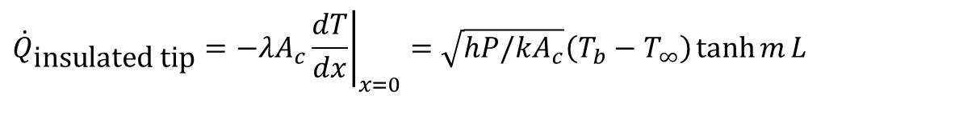
CASE 2 INSULATED FIN TIP
Negligible heat loss from fin tip (Insulated fin tip, ( )
that is
From which we obtain hence the heat transfer rate is:
$${\dot{Q}}_{\text{insulated} \text{tip}}=−λA_{c}{\left.\frac{dT}{dx}\right|}_{x=0}=\sqrt{hP/kA_{c}}\left(T_{b}−T_{∞}\right)\tanh{m}L$$

Slide 42
Case 3: Convection at the end (or combined convection and radiation)
Invoking the general solution and substituting the boundary conditions we obtain:

Slide 43
SOLUTIONS FOR CASE 3
The temperature profile and heat transfer rate are given by:

Slide 44
FIN EFFECTIVENESS
Fins are used to increase the heat transfer from a surface by increasing the effective surface area.
However, a fin itself represents a conduction resistance to heat transfer from the original surface.
For this reason, there is no assurance that the heat transfer rate will be increased through the use of fins. An assessment of this matter may be made by evaluating the fin effectiveness ε_{f}.
It is defined as the ratio of the fin heat transfer rate to the heat transfer rate that would exist without the fin. is the fin cross-sectional area

Slide 45
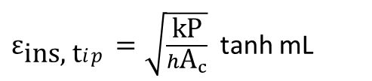
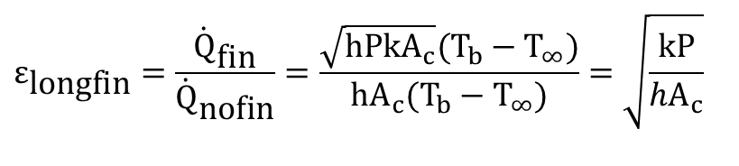
FIN EFFECTIVENESS
$$ε_{\text{longfin}}=\frac{{\dot{Q}}_{\text{fin}}}{{\dot{Q}}_{\text{nofin}}}=\frac{\sqrt{\text{h}\text{P}\text{k}{\text{A}}_{c}}(T_{b}−T_{∞})}{\text{h}{\text{A}}_{c}(T_{b}−T_{∞})}=\sqrt{\frac{\text{k}\text{P}}{h{\text{A}}_{c}}}$$
$ε_{\text{ins}\text{, }\text{t}ip}=\sqrt{\frac{\text{k}\text{P}}{h{\text{A}}_{c}}}$ tanh mL
Comments:
Fin effectiveness is enhanced by the choice of a material of high thermal conductivity. Aluminium alloys are mostly common. Copper and iron are other options. Although copper is superior from the stand-point of thermal conductivity, aluminium alloys are the more common choice because of additional benefits related to lower cost and weight.
Fin effectiveness is also enhanced by increasing the ratio of the perimeter to the cross-sectional area. For this reason the use of thin plate and slender pin, but closely spaced fins, is preferred, with the proviso that the fin gap must not be reduced to a value for which flow between the fins is severely impeded, thereby reducing the convection coefficient.
The use of fins is most effective in applications involving a low convection heat transfer coefficient. Thus, the use of fins is more easily justified when the medium is a gas instead of a liquid and the heat transfer is by natural convection instead of by forced convection

Slide 46
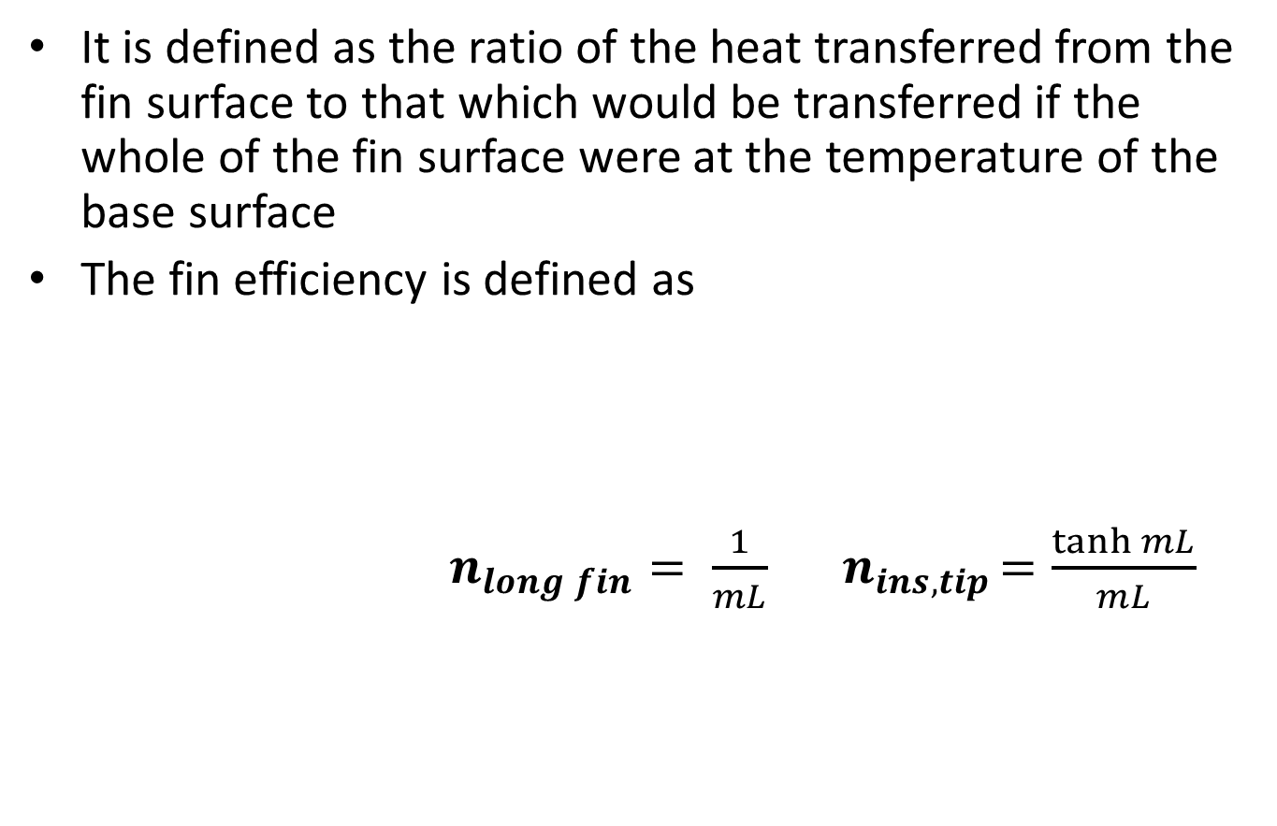
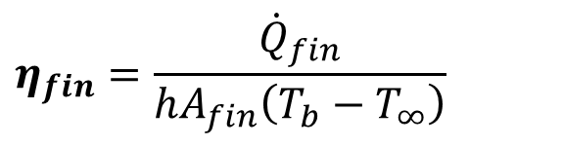
FIN EFFICIENCY
It is defined as the ratio of the heat transferred from the fin surface to that which would be transferred if the whole of the fin surface were at the temperature of the base surface
The fin efficiency is defined as
$n_{long fin}= \frac{1}{mL} { n}_{ins, tip}=\frac{\tanh{mL}}{mL}$
$$η_{fin}=\frac{{\dot{Q}}_{fin}}{{hA}_{fin}\left(T_{b}−T_{∞}\right)}$$

Slide 47
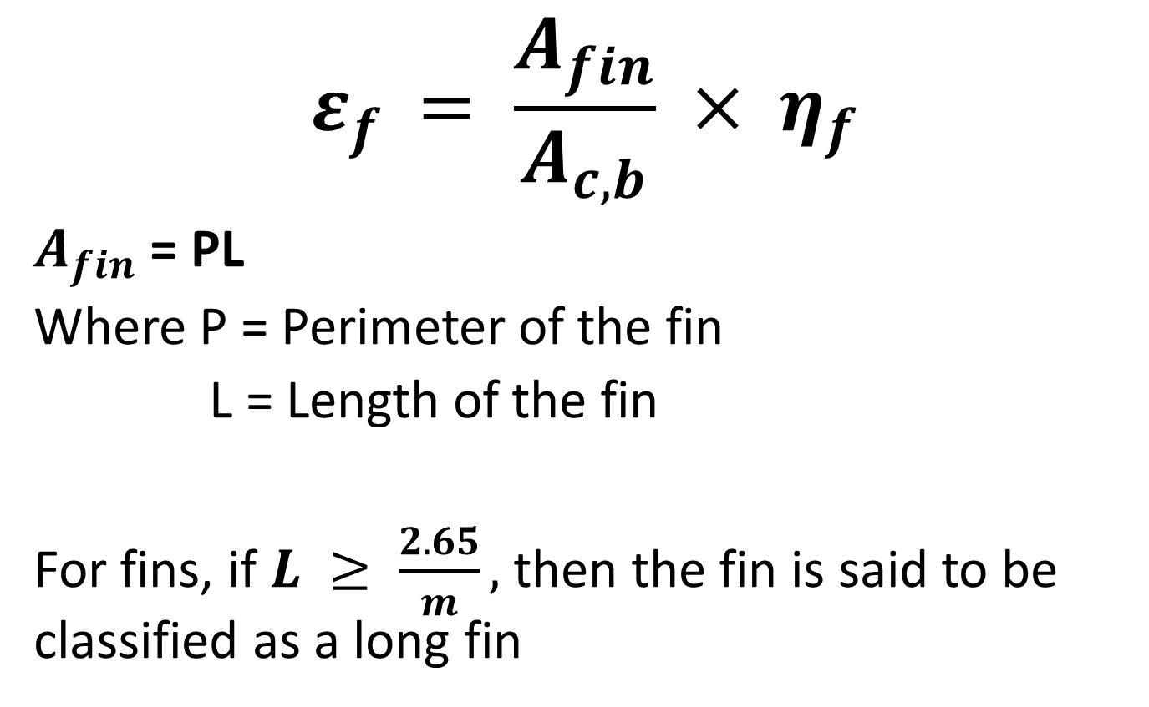
RELATION BETWEEN FIN EFFICIENCY AND EFFECTIVENESS
$$ε_{f }= \frac{A_{fin}}{A_{c, b}} × η_{f}$$
$A_{fin}$ = PL
Where P = Perimeter of the fin
L = Length of the fin
For fins, if $L ≥ \frac{2.65}{m},$then the fin is said to be classified as a long fin

Slide 48
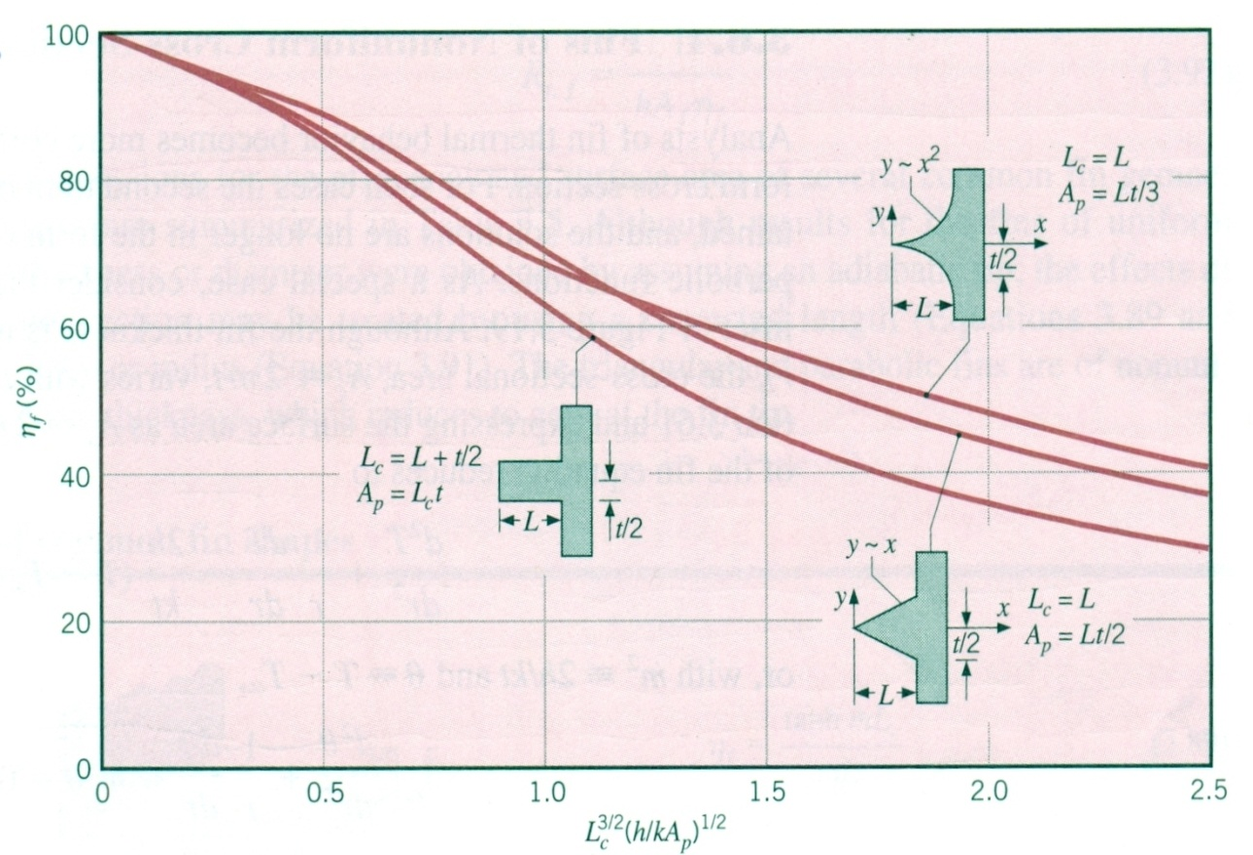
Fin efficiency for straight fins
Rectangular, triangular and parabolic fins

Slide 49
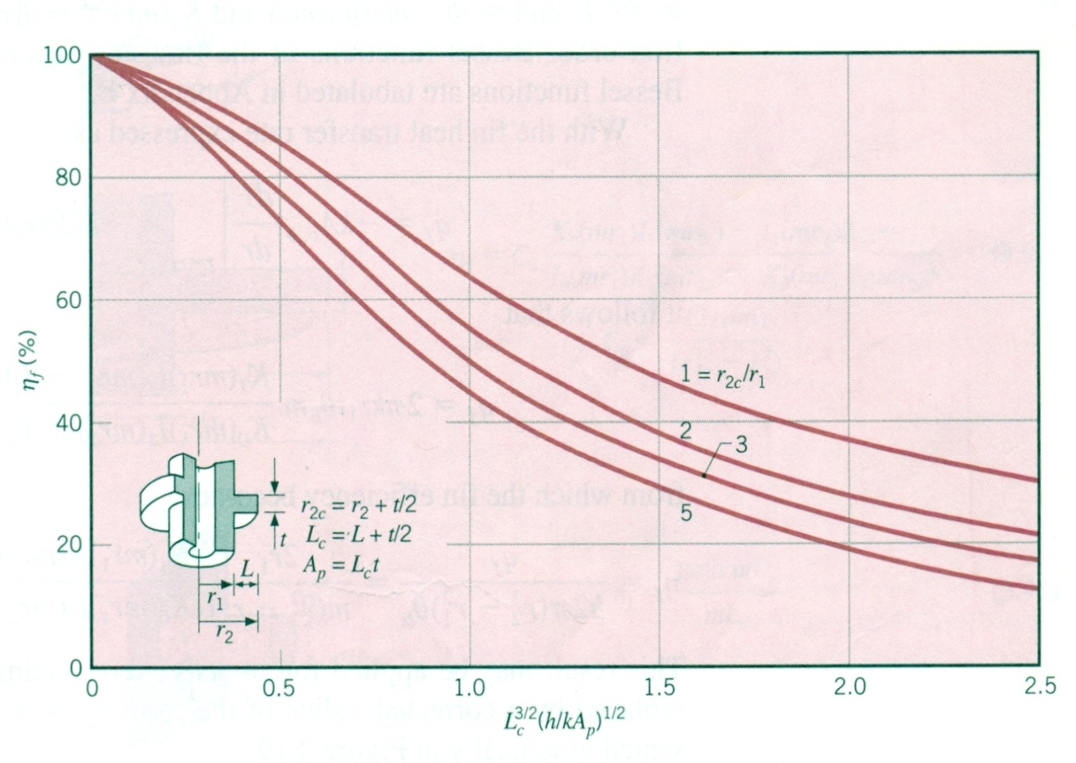
Fin efficiency chart for annular fins
Annular fins of rectangular profile

Slide 50
WORKED EXAMPLE 2.1
Aluminium fins 1.5 cm wide and 1.0 mm thick are placed on 2.5 cm diameter tube to dissipate the heat. The tube surface temperature is 170 °C, and the ambient fluid temperature is 25 °C. Calculate the heat loss per fin for . Assume for aluminium.
SOLUTION
We compute the heat transfer by using the fin efficiency curves and formulae in Figures 21 and 22 respectively. The parameters needed are

Slide 51
CONTINUATION OF SOLUTION
From figure 21, the efficiency of the fins, η_{f} = 82%.
The heat transferred if the entire fin were at the base temperature with both sides of the fin exchanging heat is given by
Hence the actual heat transfer from the fin surface is

Slide 52
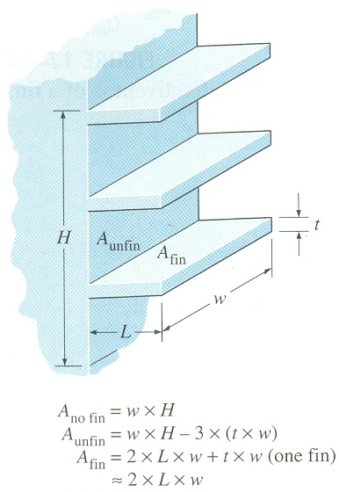
Overall effectiveness- a better measure of performance of finned surfaces
Total heat transfer from a surface will consider the unfinned portion of the surface as well as the fins
Overall effectiveness is defined as:

Slide 53
Overall surface efficiency
The overall surface efficiency η_{o} characterises an array of fins and the base surface to which they are attached. It is defined as

Slide 54
Pitch
The pitch, S, of an array of regularly spaced fins (Figure 23) is defined as the distance from a point on a fin to the corresponding point on an adjacent fin along a vertical or horizontal line between the two fins. It can be obtained by dividing a given distance by the number of fins within that distance. The pitch is the sum of the fin thickness and the inter-fin spacing and is the unit that is repeated throughout the fin array.

Slide 55
COMMENTS (FOR PRACTICAL FIN DESIGN):
1. Fin length must be such that mL =1 is an ideal fin length, which is a compromise between heat transfer, performance and fin size. For design purposes, a good guide is to assume that fins should not be used unless , where b is the characteristic thickness of the fin.
2. Fins should also have a high thermal conductivity and hence would not normally be used on non-metallic surface.

Slide 56
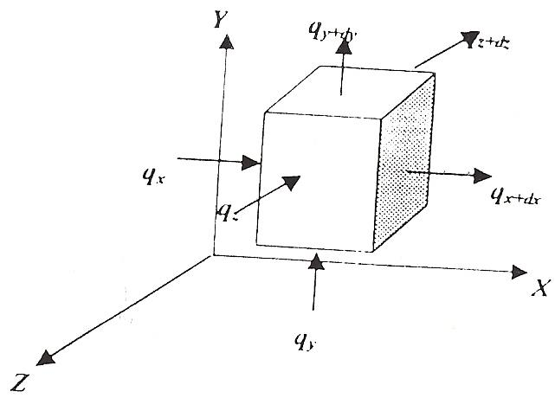
THREE DIMENSIONAL HEAT CONDUCTION
Illustration of heat flow in three dimensions
From energy balance:[Heat conducted into the volume + Heat generated within the volume] = {heat conducted away from the volume + change in internal energy}

Slide 57
Derivation of general heat conduction differential equation
For unsteady state, change in internal energy is not zero and temperature is a function of time
Heat conducted into the volume is given by Q and during time dt , total energy is (Q_{x} + Q_{y} +Q_{z})dt
If is the rate of generation of heat energy per unit volume
Total energy generated is given by dxdydzdt
Heat conducted away from the volume is
Change in internal energy
Where,

Slide 58
General Heat Conduction Equation
From the statement of energy balance
(2.58)
Now from Taylor’s series expansion:
And Substituting for the area term in equation 2.28 we obtain:
This is only the simplification for the x-component but the same analysis is carried out for the y and z-components

Slide 59
General heat conduction equation in three dimensions.
Simplifying the y and z terms as previously carried out the x-component we finally obtain the equation:
And dividing by dvdt we obtain the general heat conduction equation before specific simplifications as:

Slide 60
Case 1 :Fourier-Biot equation if only λ is assumed constant
λ can be taken out and the differential operation carried out resulting in (2.60) as:

Slide 61
Case 2: If λ is constant and
These conditions result in the FOURIER’S equation (2.61):

Slide 62
Case 3: λ assumed constant at steady-state with
These conditions result in the POISSON equation (2.62)

Slide 63
case 4: steady state-conditions with λ assumed constant and
These conditions result in the LAPLACE Equation (2.63)

Slide 64
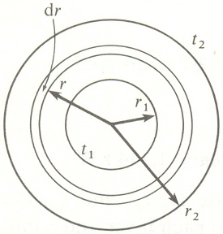
1-dimensional heat equation in cylindrical coordinates
Applying the energy balance equation to an element we proceed as follows:

Slide 65
Heat Conduction Equation in cylindrical coordinates
We arrive at equation (2.65) by dividing through the previous equation by λ since it is assumed constant
Varied forms of this equation are written depending on the problem being solved. These would be considered in more advanced course modules.

Slide 66
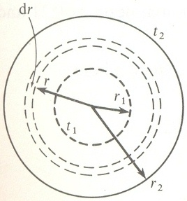
1-dimensinal heat conduction equation in spherical coordinates with λ = constant
We apply the energy balance on an element and obtain the following:
Dividing through the above expression by the elemental volume we obtain:

Slide 67
Unsteady heat flow
In heat transfer, bodies are observed to behave like a “lump” whose interior remains essentially uniform at all times during a heat transfer process. The initial temperature of the body in a given environment (α, T∞) is (T_{i}, t = 0) and the temperature of such bodies may be taken to be a function of time only, i.e. T (t). Heat transfer analysis that utilizes this idealization is known as lumped capacitance method of analysis and it provides great simplification to certain classes of heat transfer without much loss of accuracy from exact solutions. The following questions can be answered with this analysis
The temperature of the body after a time t.
The time taken by the body to attain or reach a defined temperature in a given environment.
The rate of heat transfer between the body and the environment at any time t as determined by Newton’s law of cooling as
The total amount of heat transfer between the body and the environment over the time interval (t = 0 to t) is , simply obtained from the rate of change of internal energy of the body.
The upper limit of heat transfer from the body as obtained when the body reaches the temperature of the environment i.e.

Slide 68
Criteria for unsteady heat analysis
We develop the criteria for analysis by doing the following:
Approximating the shape of the body as being (i) a slab (ii) a cylinder and (iii) a sphere
Determining the characteristic length Lc of the body where
Determining the governing parameter for lumped capacitance analysis called the Biot Number (B_{i})
Criteria applicable with about 5% loss of accuracy when B_{i} < 0.1. So first step is to evaluate B_{i} and decide whether to use the method. In doing so we define the following;
For a slab,
For a cylinder,
For a sphere,

Slide 69
Consider a hot metal forging (Figure 27) that is initially at a uniform temperature T and is quenched by immersing it in a liquid of lower temperature . If the quenching is said to begin at time t = 0, the temperature of the solid will decrease for time t > 0, until it eventually reaches .
The essence of the lumped capacitance method is the assumption that the temperature of the solid is spatially uniform at any instant during the transient period. This assumption implies that temperature gradients within the solid are negligible.

Slide 70
Transient Energy balance equation
In neglecting temperature gradients within the solid, we can no longer consider the problem from within the framework of the heat equation. Instead, the transient temperature response is determined by formulating an overall energy balance on the solid. This balance must relate the rate of loss at the surface to the rate of change of the internal energy. Applying Equation 1.10 to the control volume to have

Slide 71
The heart of the analysis
The Biot Number is the ratio
Where L_{c} is the characteristic length and defined as (L_{c} = V/A_{s}), V is the volume and A_{s} is the total surface area.
If the Biot Number ≤ 0.1 it implies that λ is so high that the conduction resistance is very low hence the temperature is uniform. In this case, T = T(t)
Since internal energy changes as temperature changes, the internal energy is expressed as mcdT = ρVcdT
which is a dimensionless parameter

Slide 72
We derive constitutive equation as follows:
Initial conditions T = T_{i} @ t = 0
Separating variables
Let b = Therefore,
Integrating we obtain:
Substituting the boundary conditions we have
(2.70)

Slide 73
Temperature distribution for a lumped capacitance
Equation 2.70 may be used to determine the time required for the solid to reach some temperature T as: (2.71)
Equation 2.71 may be used to compute the temperature reached by the solid at some time t.
The foregoing results indicate that the difference between the solid and fluid temperature must decay exponentially to zero as t approaches infinity.

Slide 74
TUTORIAL PROBLEMS
PROBLEM 14
A very, long copper rod [k = 372 W/m ºC] 2.5 cm in diameter has one end maintained at 90 ºC. The rod is exposed to a fluid whose temperature is 40 ºC. The heat transfer coefficient is 3.5 W/m2 ºC. Calculate the heat given up by the rod.

Slide 75
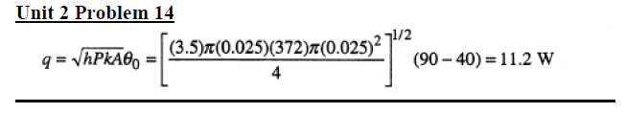
SOLUTION

Slide 76
TUTORIAL PROBLEMS
PROBLEM 15
A long thin copper [k = 372 W/m ºC] 5 mm in diameter is exposed to an environment at 20 ºC. The base temperature of the rod is 120 ºC. The heat transfer coefficient between the rod and the environment is 20 W/ (m² ºC). Calculate the heat given up by the rod.

Slide 77
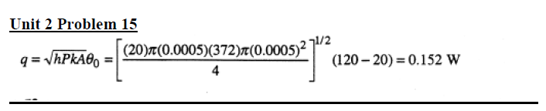
SOLUTION

Slide 78
TUTORIAL PROBLEMS
PROBLEM 16
A circumferential fin of rectangular profile having a thickness of 1.0 mm and a length of 2.0 cm is placed on a 2.0-cm-diameter tube. The tube temperature is 150 ◦C, the environment temperature is 20◦C, and h=150 W/(m²◦C). The fin is aluminium.
Calculate the heat lost by the fin.

Slide 79
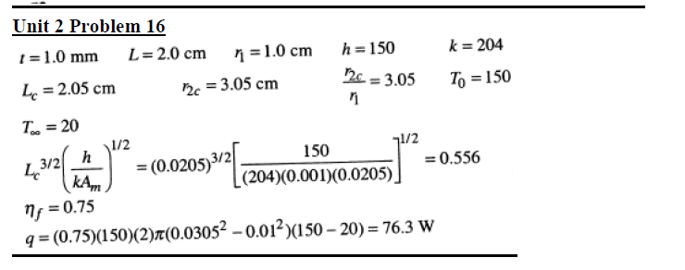
SOLUTION

Slide 80
END OF LECTURES
AS RECORDED IN LUKE 19:13
WORK WITH THE MATERIALS PROVIDED AND “OCCUPY TILL I COME”
THANK YOU

